Slide 1
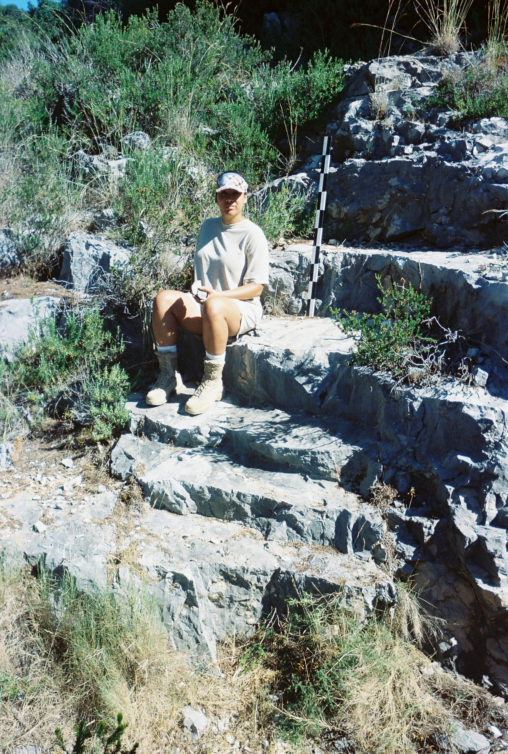
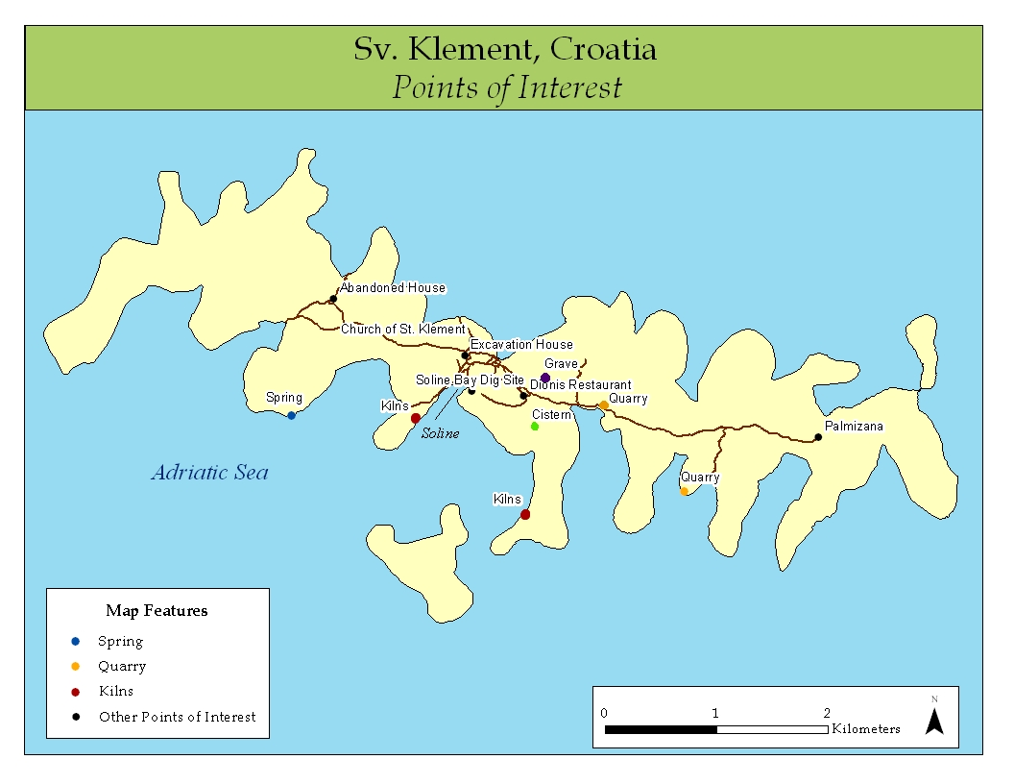
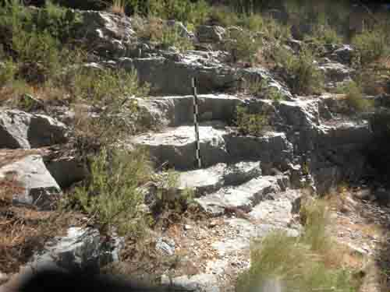
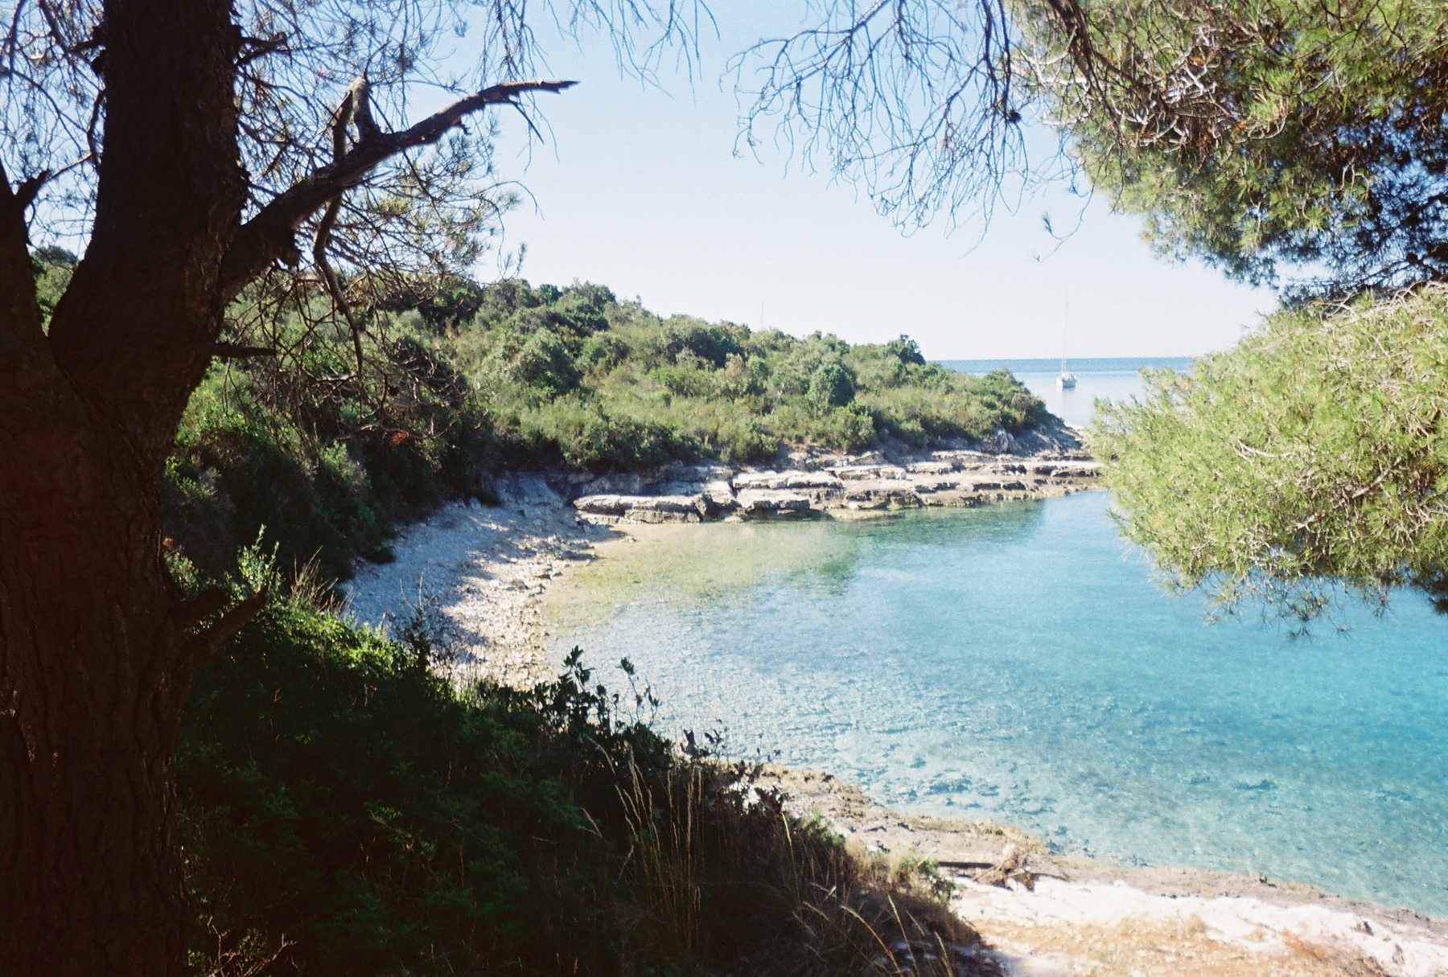
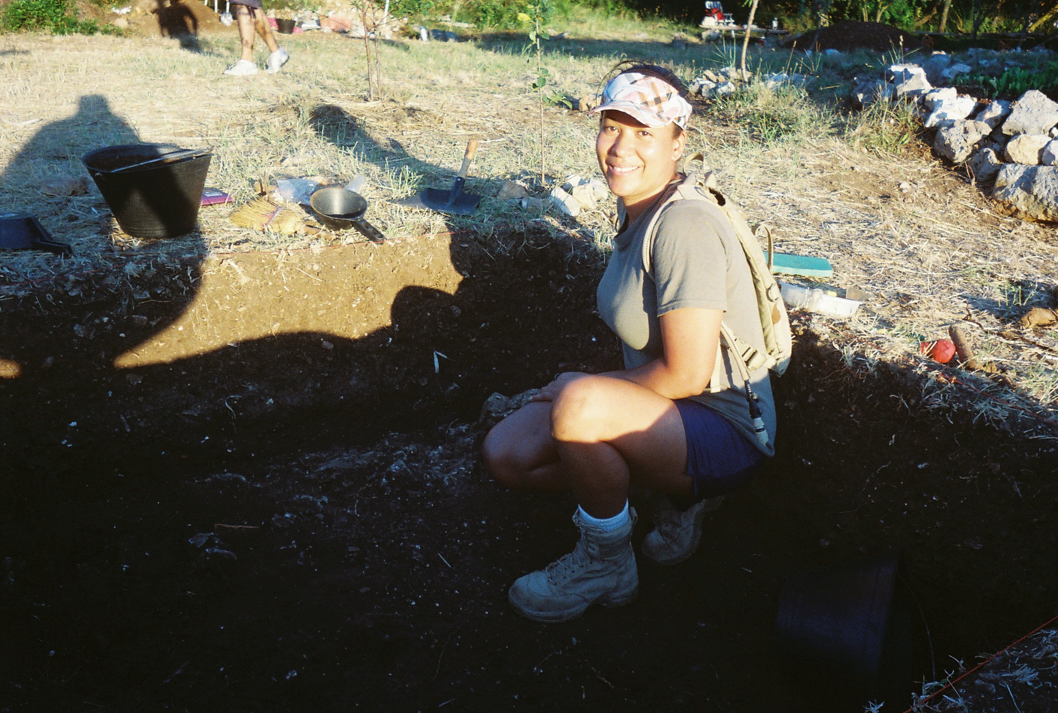
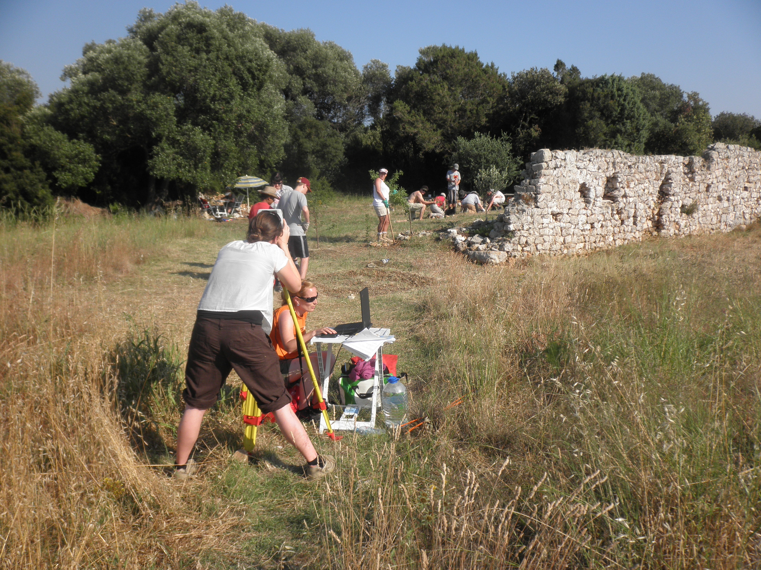
ARCHEOLOGY AND QUARRIES ON ST.CLEMENT,CROATIA
Laura Thompson-Woodland, University of St. Thomas
Building stone for the villa came from a quarry in the neighboring bay. The Romans started
quarrying limestone at the top of the rock and worked their way down to the ground.
The island is located in the Adriatic Sea and was important to connecting the Mediterranean area through trade in the Greco-Roman period.

